Slide 1
ES插件以及ltr流程分析

Slide 2
ES插件加载流程
所有的插件都需要在根目录下面包含一个文件：
plugin-descriptor.properties
这个文件里面有一些信息：
version=6.2.5
name=ltr
classname=com.o19s.es.ltr.LtrQueryParserPlugin

Slide 3
插件加载流程：
es启动
Elasticsearch.main
Bootstrap.init(!daemonize, pidFile, quiet, initialEnv);
Node(environment)
this.pluginsService = new PluginsService(tmpSettings, environment.configFile(), environment.modulesFile(), environment.pluginsFile(), classpathPlugins);
extractAllPlugins 将plugins目录里面的路径添加到list
加载pulgins plugin-descriptor.properties，classname定义了实现插件接口的类
loadBundles(seenBundles); 开始加载插件
插件初始化之后，在后续其他模块初始化的时候会分别注册：
比如SearchModule->registerQueryParsers->registerFromPlugin

Slide 4
SearchPlugin
扩展搜索功能,主要实现getQueries方法
ScriptPlugin:
用于扩展搜索脚本功能的附加扩展点
ActionPlugin:
处理rest请求的扩展点

Slide 5
ltr 插件 声明了SearchPlugin，ScriptPlugin，ActionPlugin，AnalysisPlugin

Slide 6
我们首先看ActionPlugin，结合ltr代码：
@Override
public List<RestHandler> getRestHandlers(Settings settings, RestController restController,
ClusterSettings clusterSettings, IndexScopedSettings indexScopedSettings,
SettingsFilter settingsFilter, IndexNameExpressionResolver indexNameExpressionResolver,
Supplier<DiscoveryNodes> nodesInCluster) {
List<RestHandler> list = new ArrayList<>();
RestSimpleFeatureStore.register(list, settings, restController);
list.add(new RestFeatureStoreCaches(settings, restController));
list.add(new RestCreateModelFromSet(settings, restController));
list.add(new RestAddFeatureToSet(settings, restController));
return unmodifiableList(list);
}
Notes:
这个实际上就是声明某个http的请求如何处理

Slide 7
public RestAddFeatureToSet(Settings settings, RestController controller) {
super(settings);
controller.registerHandler(RestRequest.Method.POST, "/_ltr/_featureset/{name}/_addfeatures/{query}", this);
controller.registerHandler(RestRequest.Method.POST, "/_ltr/{store}/_featureset/{name}/_addfeatures/{query}", this);
controller.registerHandler(RestRequest.Method.POST, "/_ltr/_featureset/{name}/_addfeatures", this);
controller.registerHandler(RestRequest.Method.POST, "/_ltr/{store}/_featureset/{name}/_addfeatures", this);
}

Slide 8
1.PUT _ltr ， RestSimpleFeatureStore.RestStoreManager接收到消息，创建.ltrstore索引
protected RestChannelConsumer prepareRequest(RestRequest request, NodeClient client) throws IOException {
String indexName = indexName(request);
if (request.method() == RestRequest.Method.PUT) {
if (request.hasParam("store")) {
IndexFeatureStore.validateFeatureStoreName(request.param("store"));
}
return createIndex(client, indexName);
……

Slide 9
2. PUT _ltr/_featureset/item_features RestSimpleFeatureStore.RestAddOrUpdateFeature接收到消息。更新特征值。
protected RestChannelConsumer prepareRequest(RestRequest request, NodeClient client) throws IOException { String indexName = indexName(request); if (request.method() == RestRequest.Method.DELETE) { return delete(client, type, indexName, request); } else if (request.method() == RestRequest.Method.HEAD || request.method() == RestRequest.Method.GET) { return get(client, type, indexName, request); } else { return addOrUpdate(client, type, indexName, request); } }

Slide 10
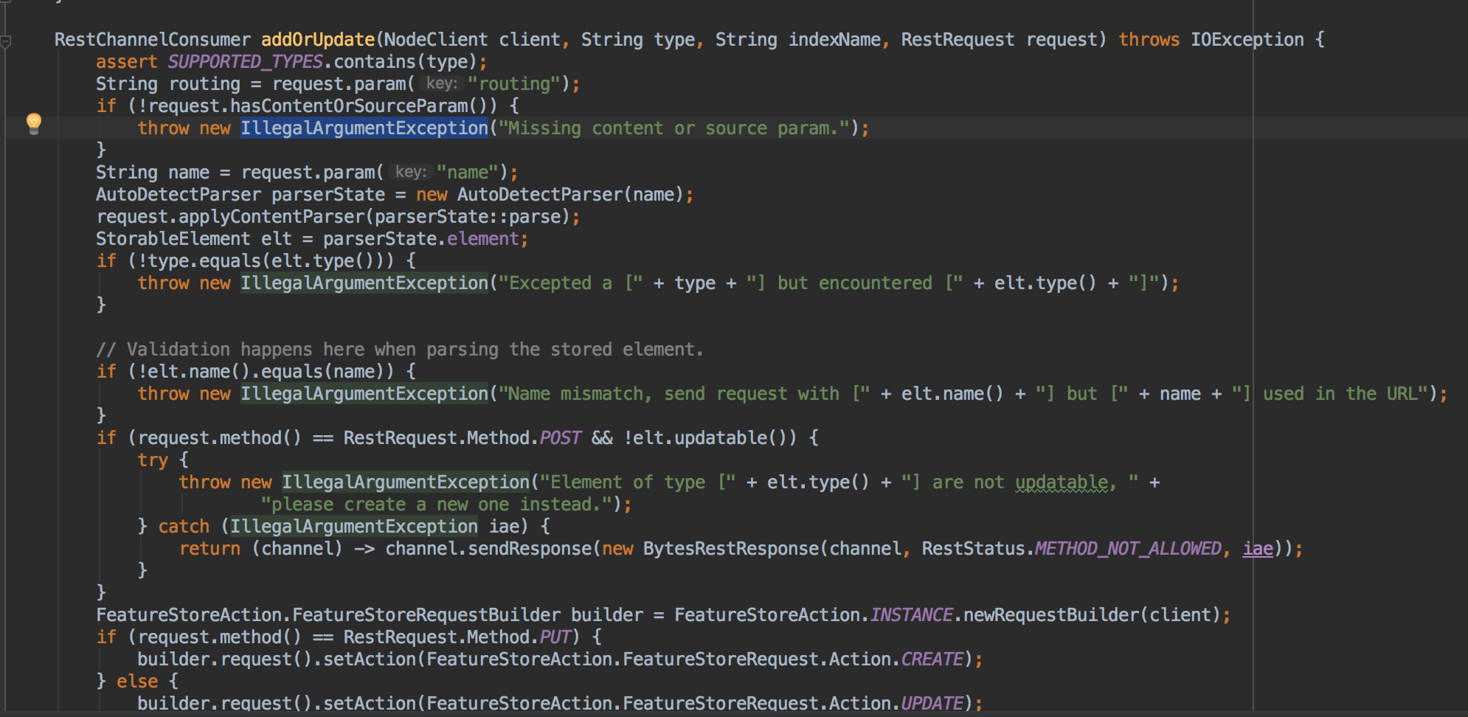

Slide 11
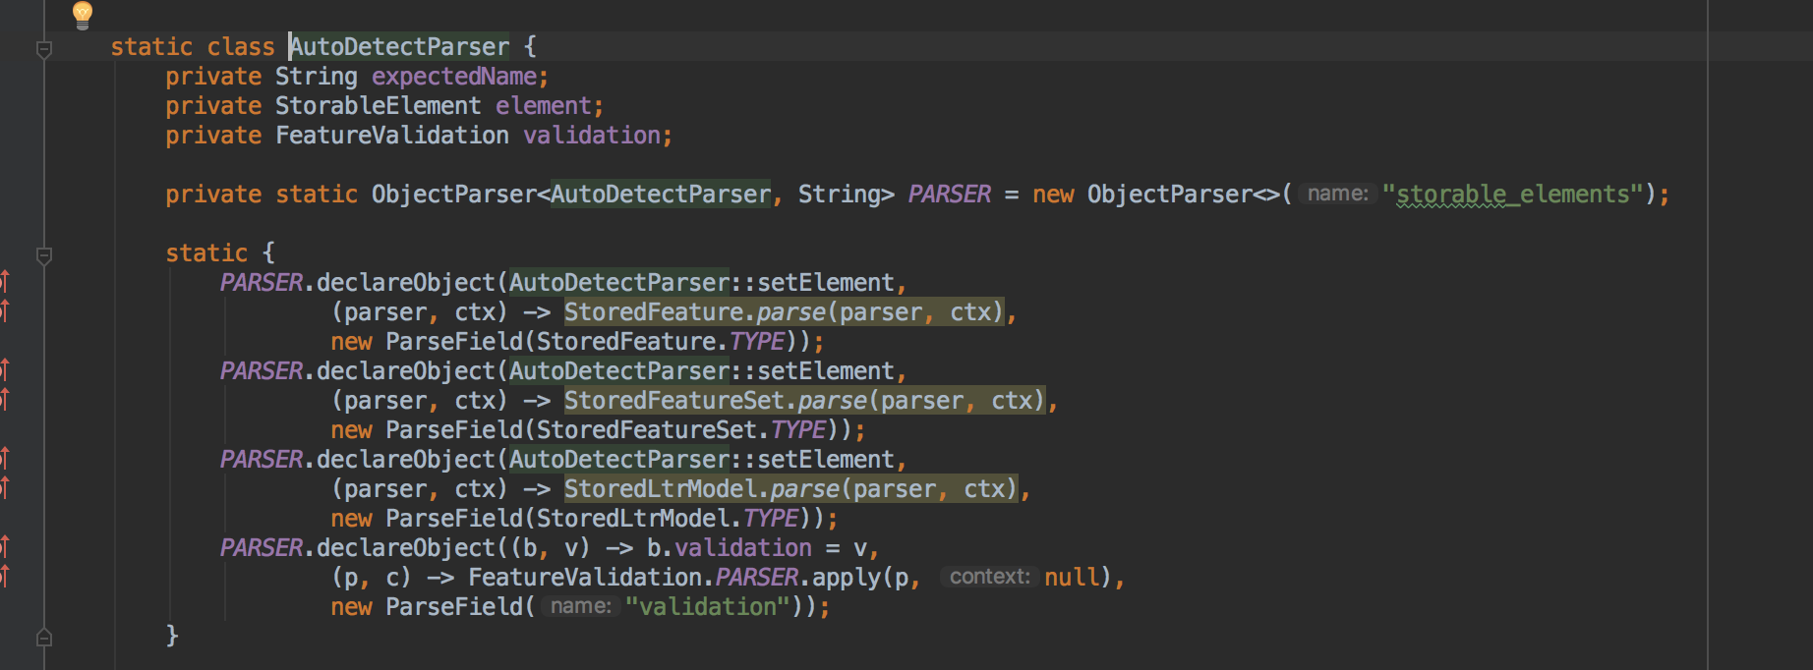

Slide 12
接下来
POST _ltr/_featureset/item_features/_createmodel
这个和前面流程类似
做完这一步可以看一下索引结构

Slide 13
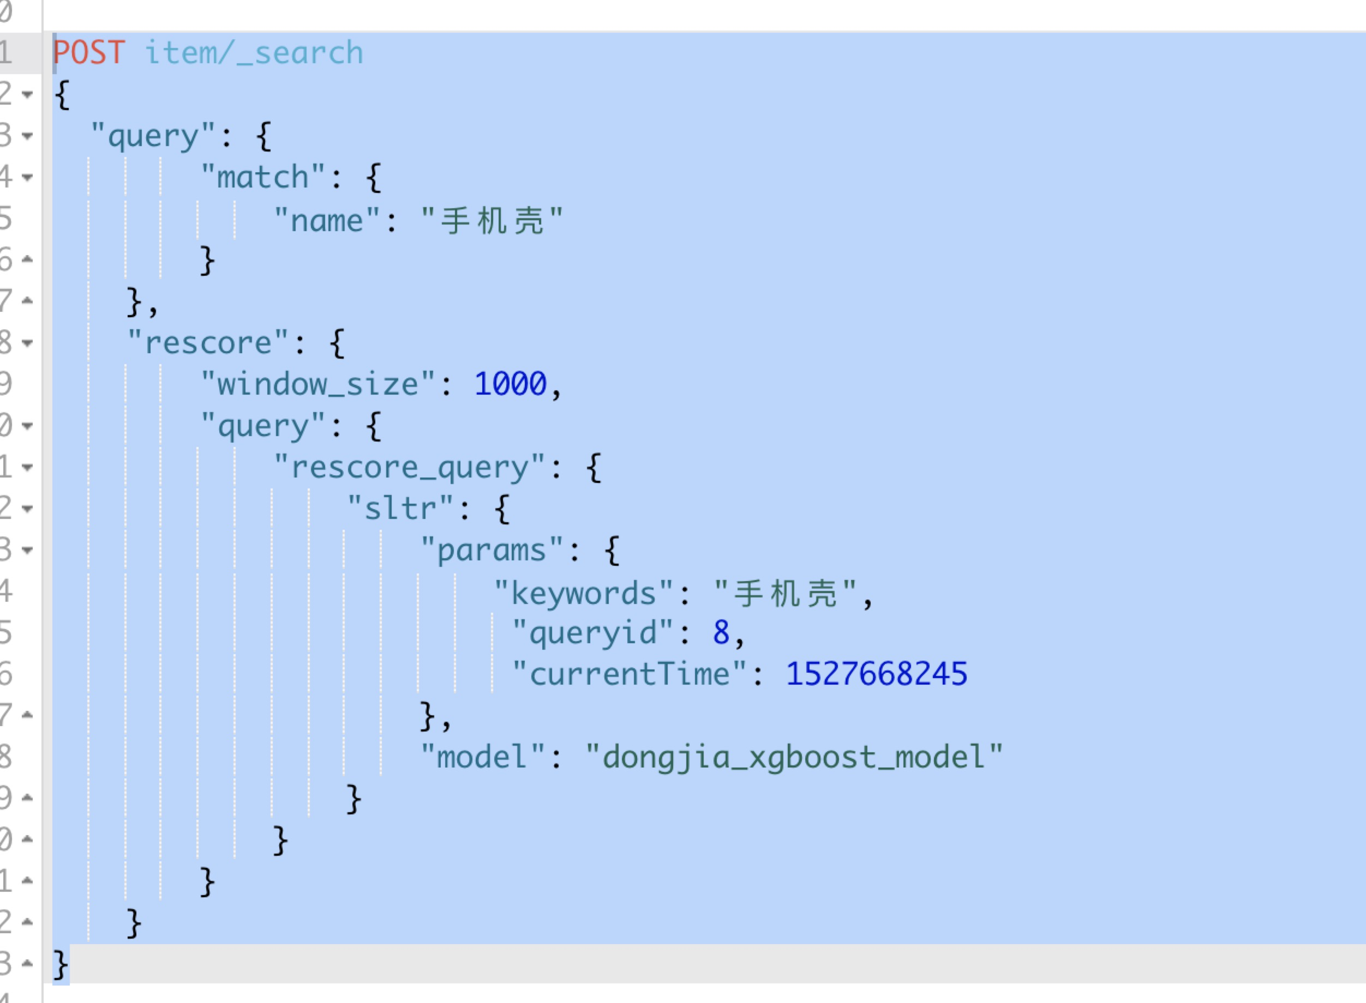

Slide 14
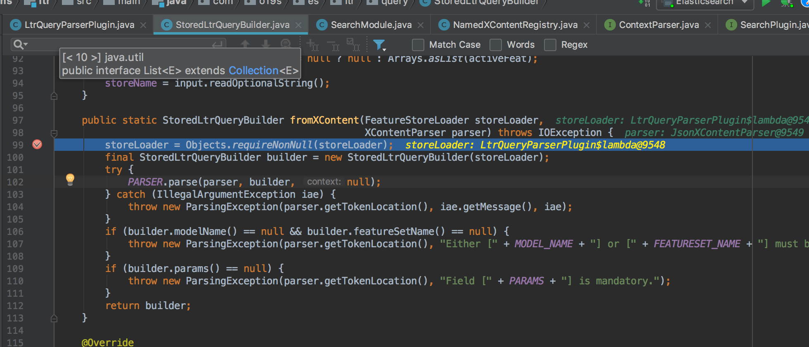

Slide 15
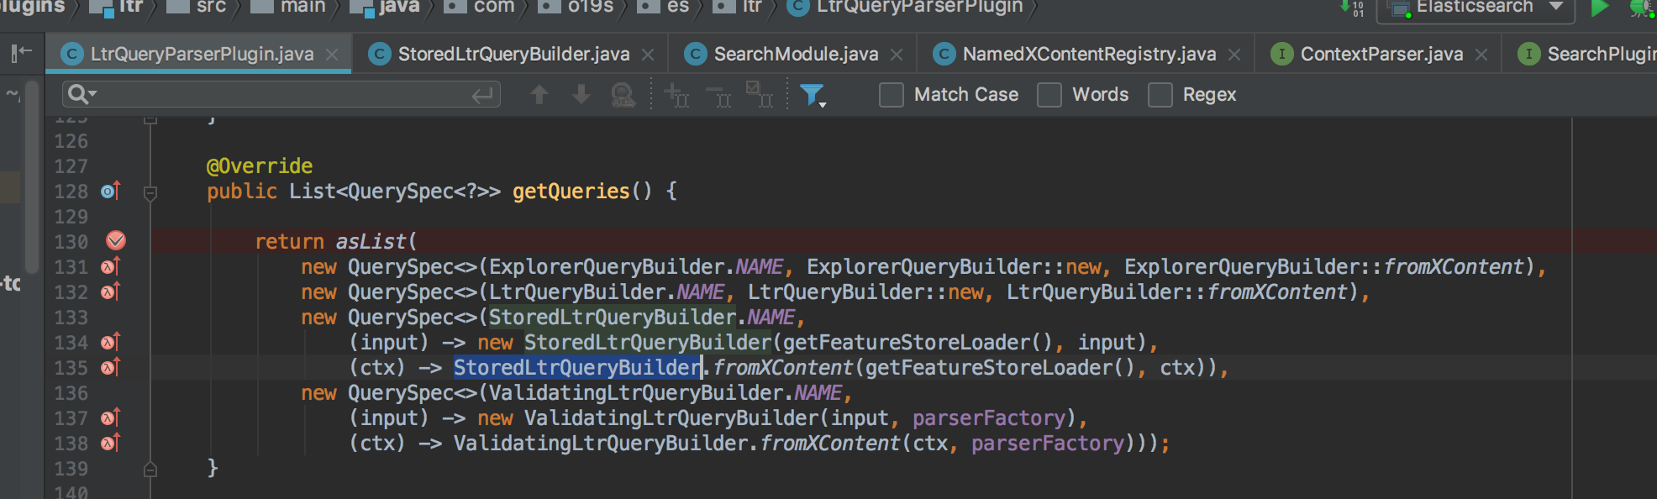
还记得我们在前面插件初始化时候配置的getQueries,当解析到sltr时调用：

Slide 16
StoredLtrQueryBuilder fromXContent
解析json，设置属性值，生成StoredLtrQueryBuilder

Slide 17
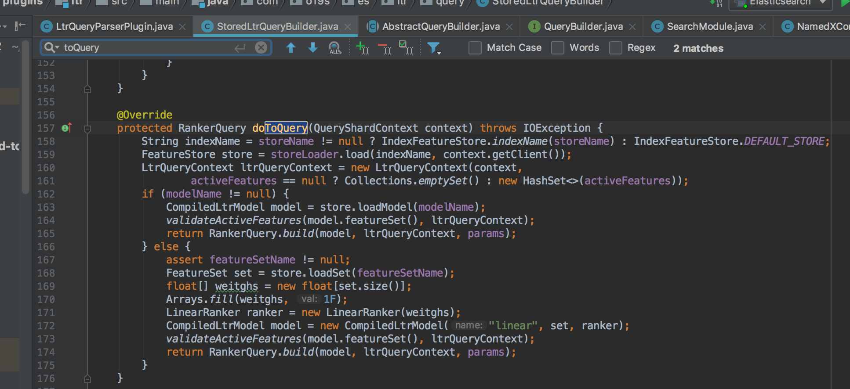
doToQuery生成Query，这个query就可以用在search或者rescore流程中

Slide 18
CompiledLtrModel model = store.loadModel(modelName);
如果加载过这个model，从cache中获取
如果没有加载过，从索引中加载和解析这个model

Slide 19
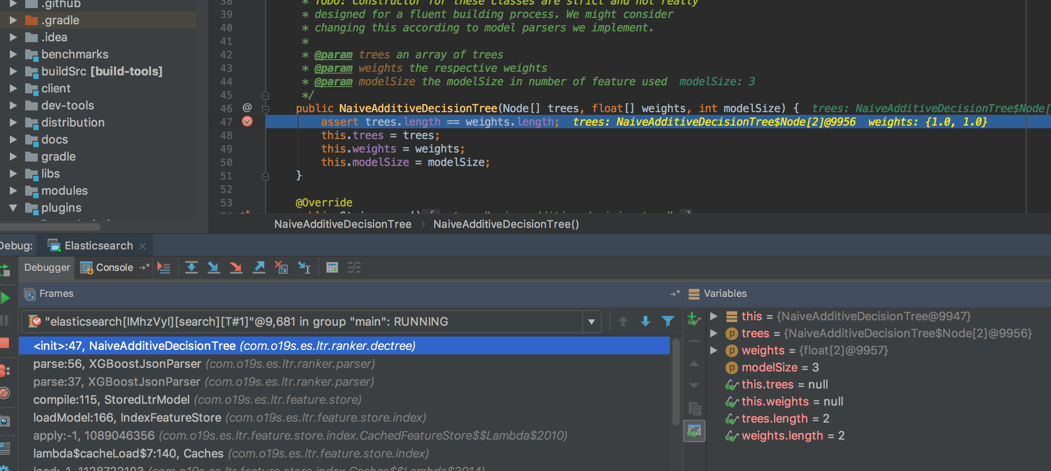
构造xgboost树

Slide 20
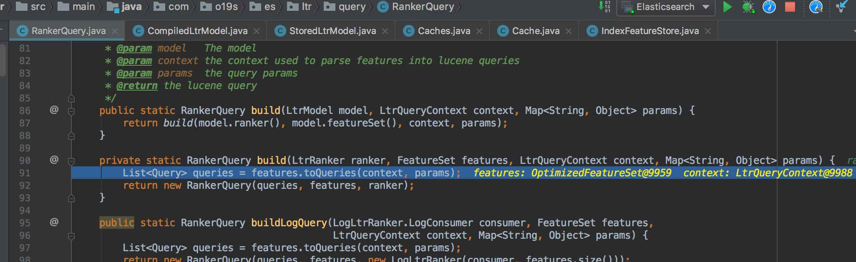
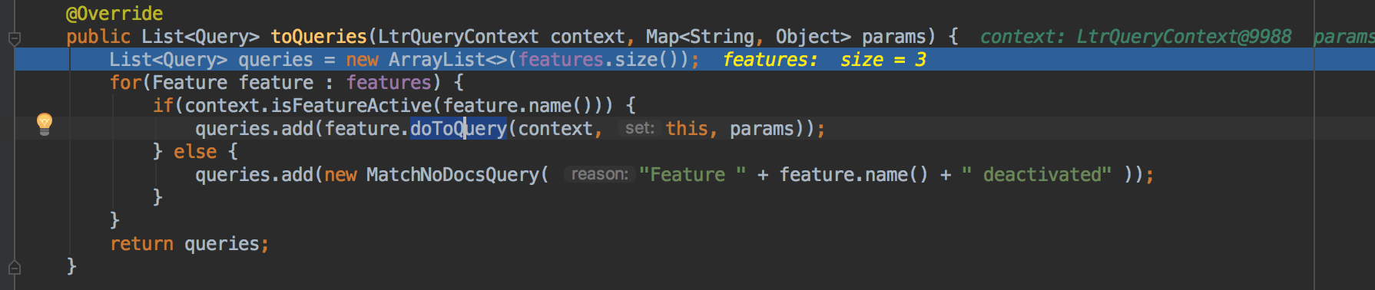
根据featureset生成query，原始代码是一个feature生成一个query

Slide 21
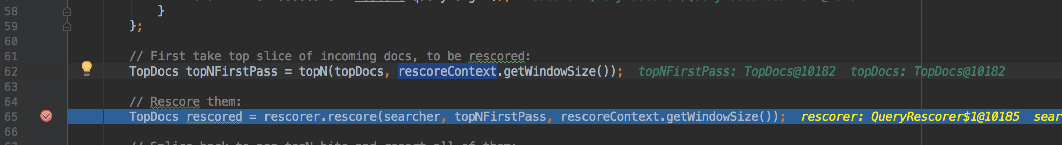
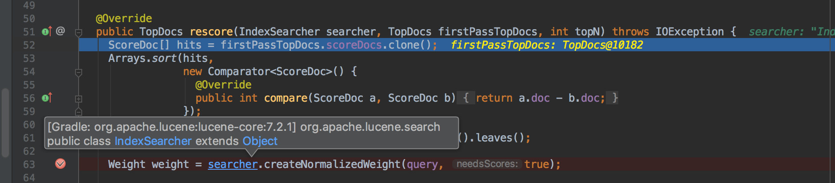
生成的query 在rescore流程使用

Slide 22
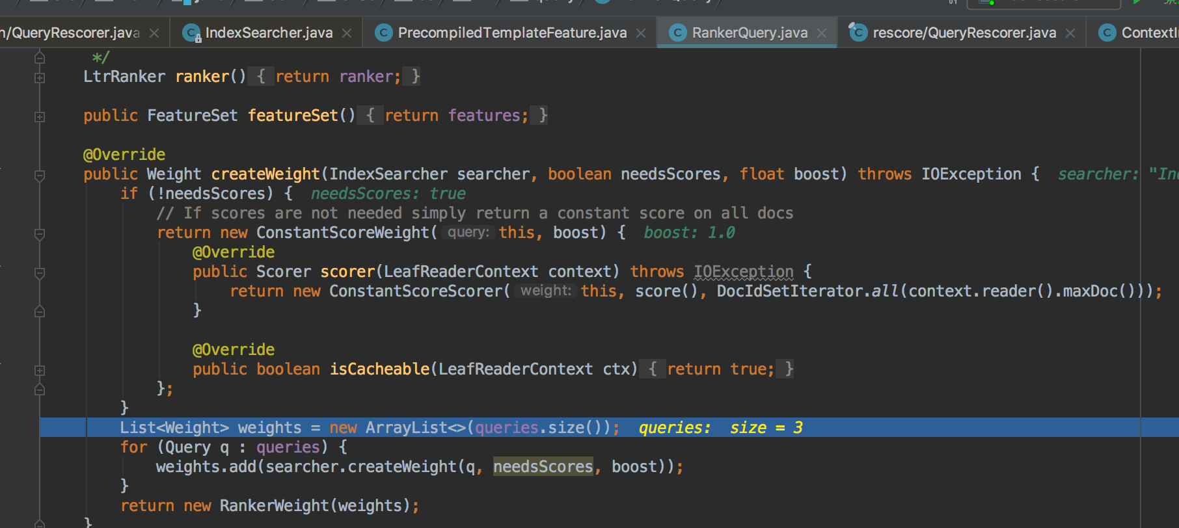
ltr自定义的query，生成weight树和score树

Slide 23
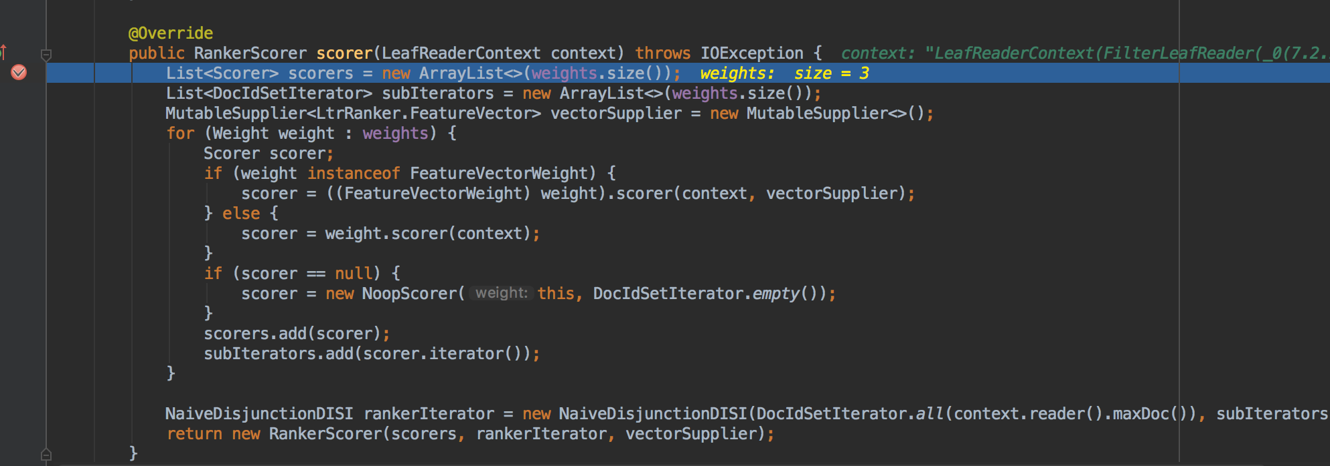

Slide 24
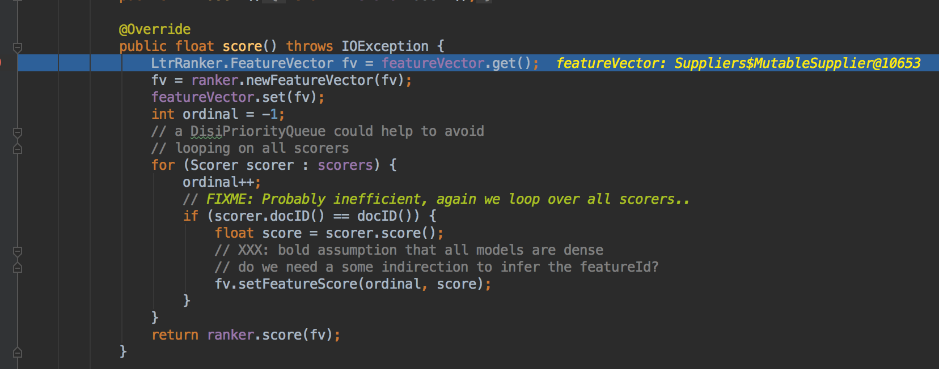

Slide 25
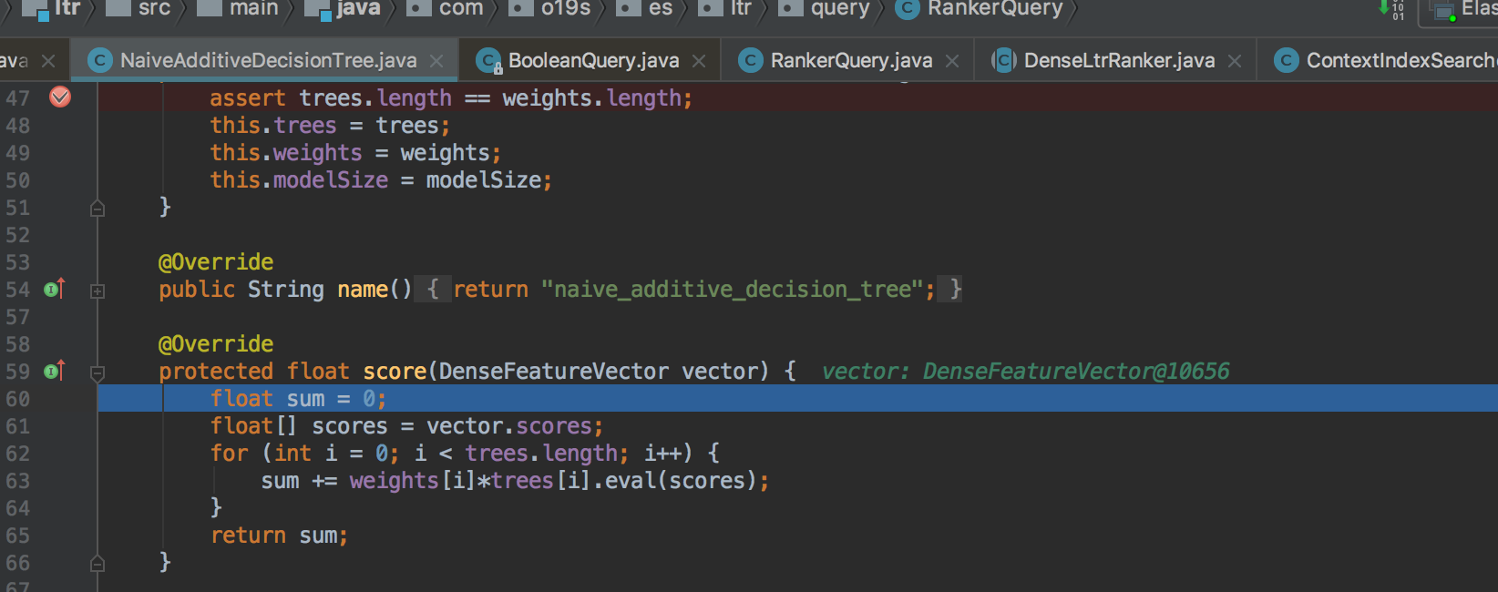
对每棵模型树算分

Slide 26
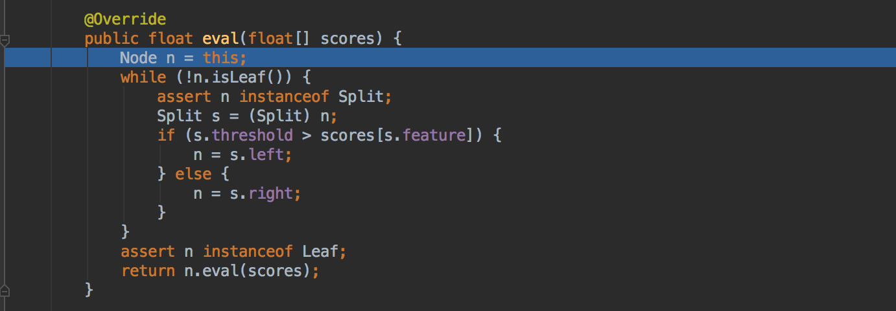
从根节点开始遍历树，算分

